Slide 1
Introduction
Week 0 – Day 1
CS-1064 Intro to Python
Dr. Panagiotis Apostolellis, Virginia Tech, Spring 2018
Notes:
Instructor lecture notes will go down here.

Slide 2
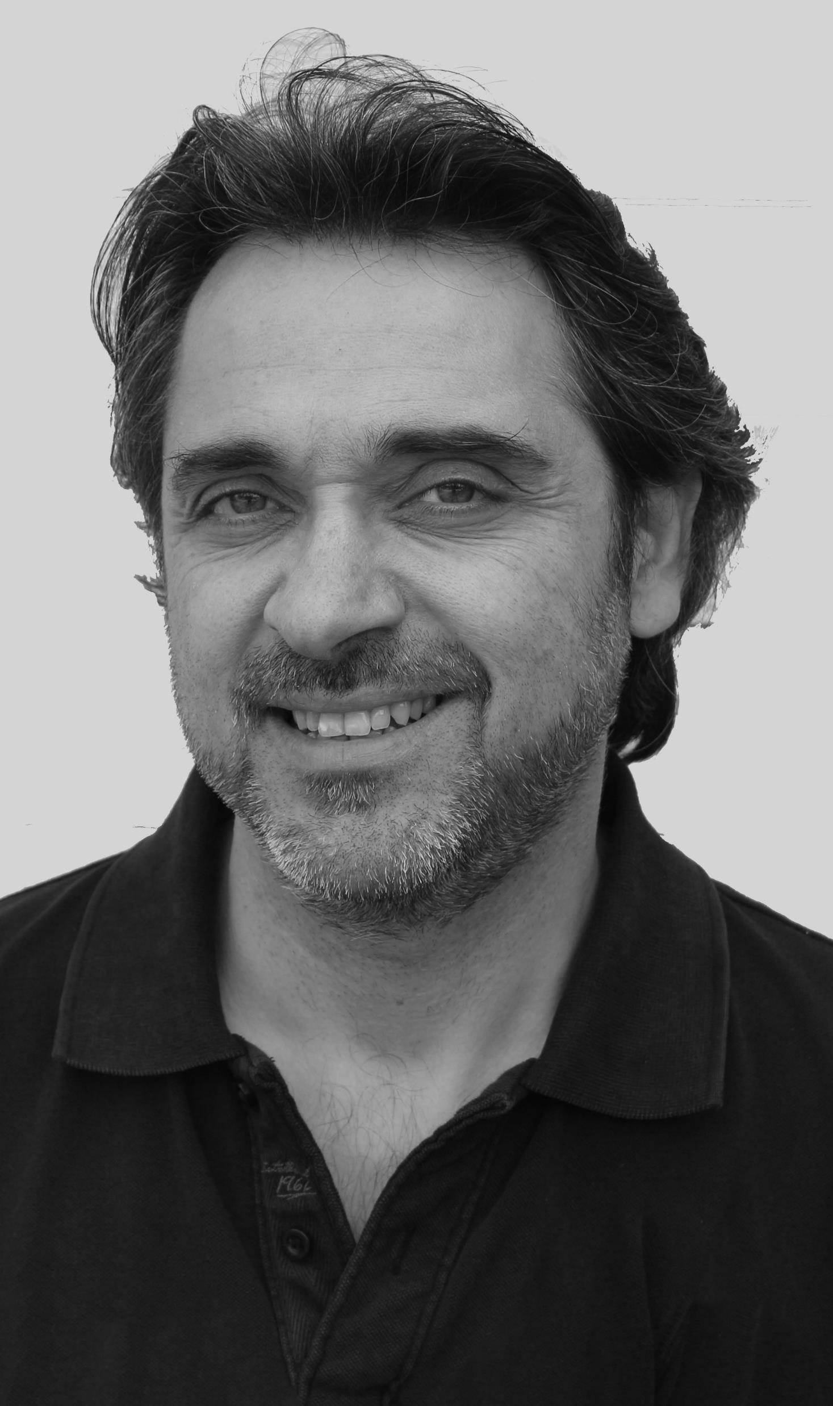
Dr. Panagiotis Apostolellis
Recent CS@VT alumnus (May 2017).
Work experience as Interactive Systems Developer & Designer in Greece (2000-2011).
Research on audience interaction and engagement for informal learning (2011-2017).
Contact me at:
www.papostolellis.com
panaga@vt.edu
@VT_panaga
Notes:
This slide is meant to introduce you to the students. You are free to customize it as you see fit. I gave them my title, discipline, research background, and teaching experience. You are free to give whatever information you think is relevant to make you seem more authoritative/approachable/etc.

Slide 3
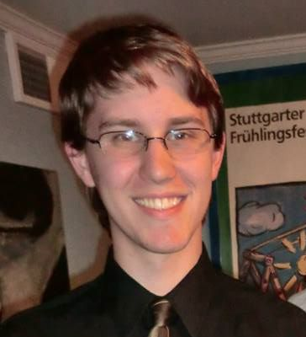
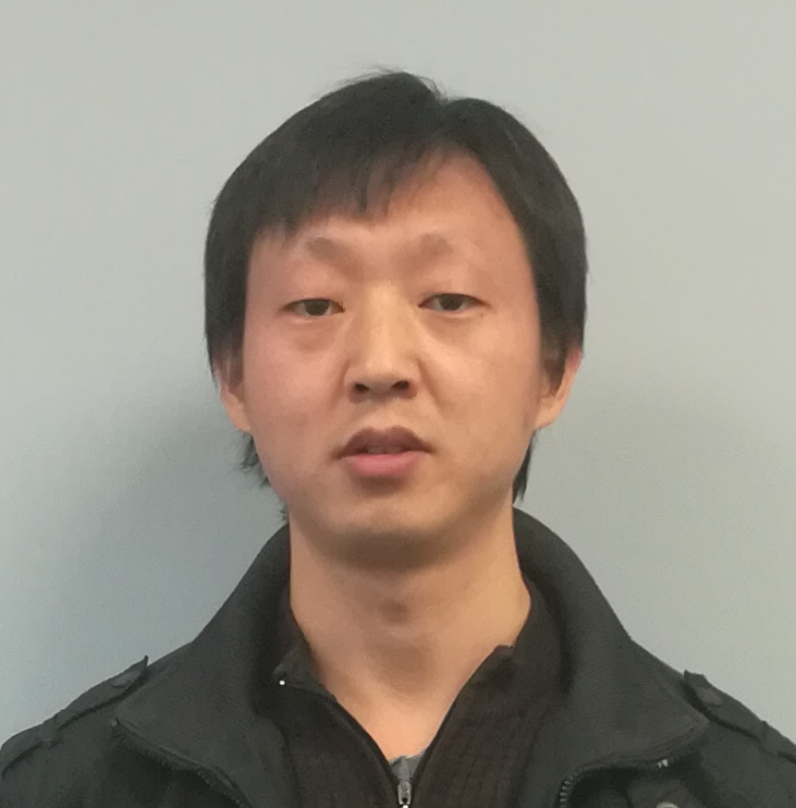
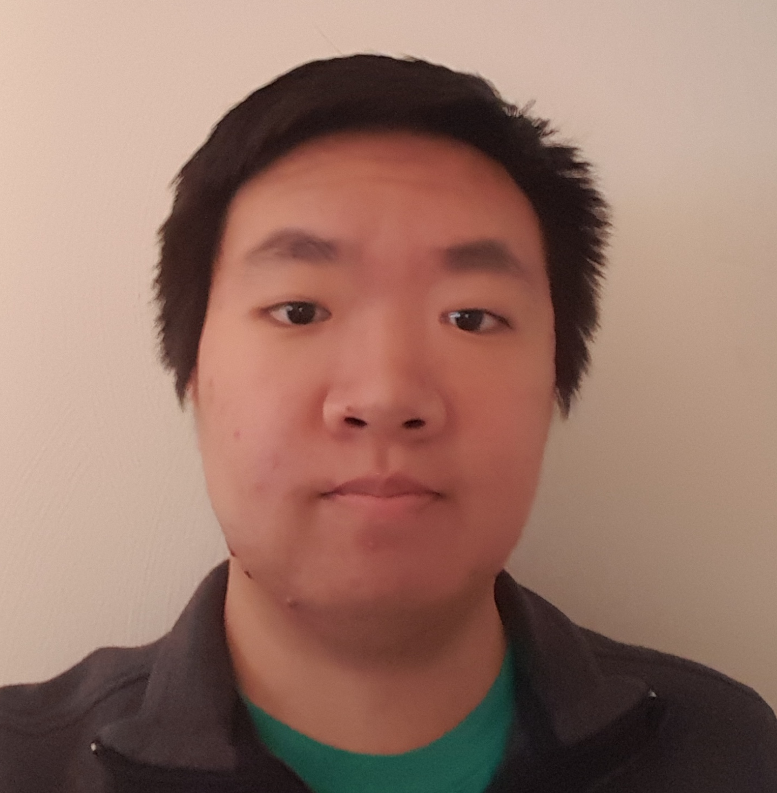
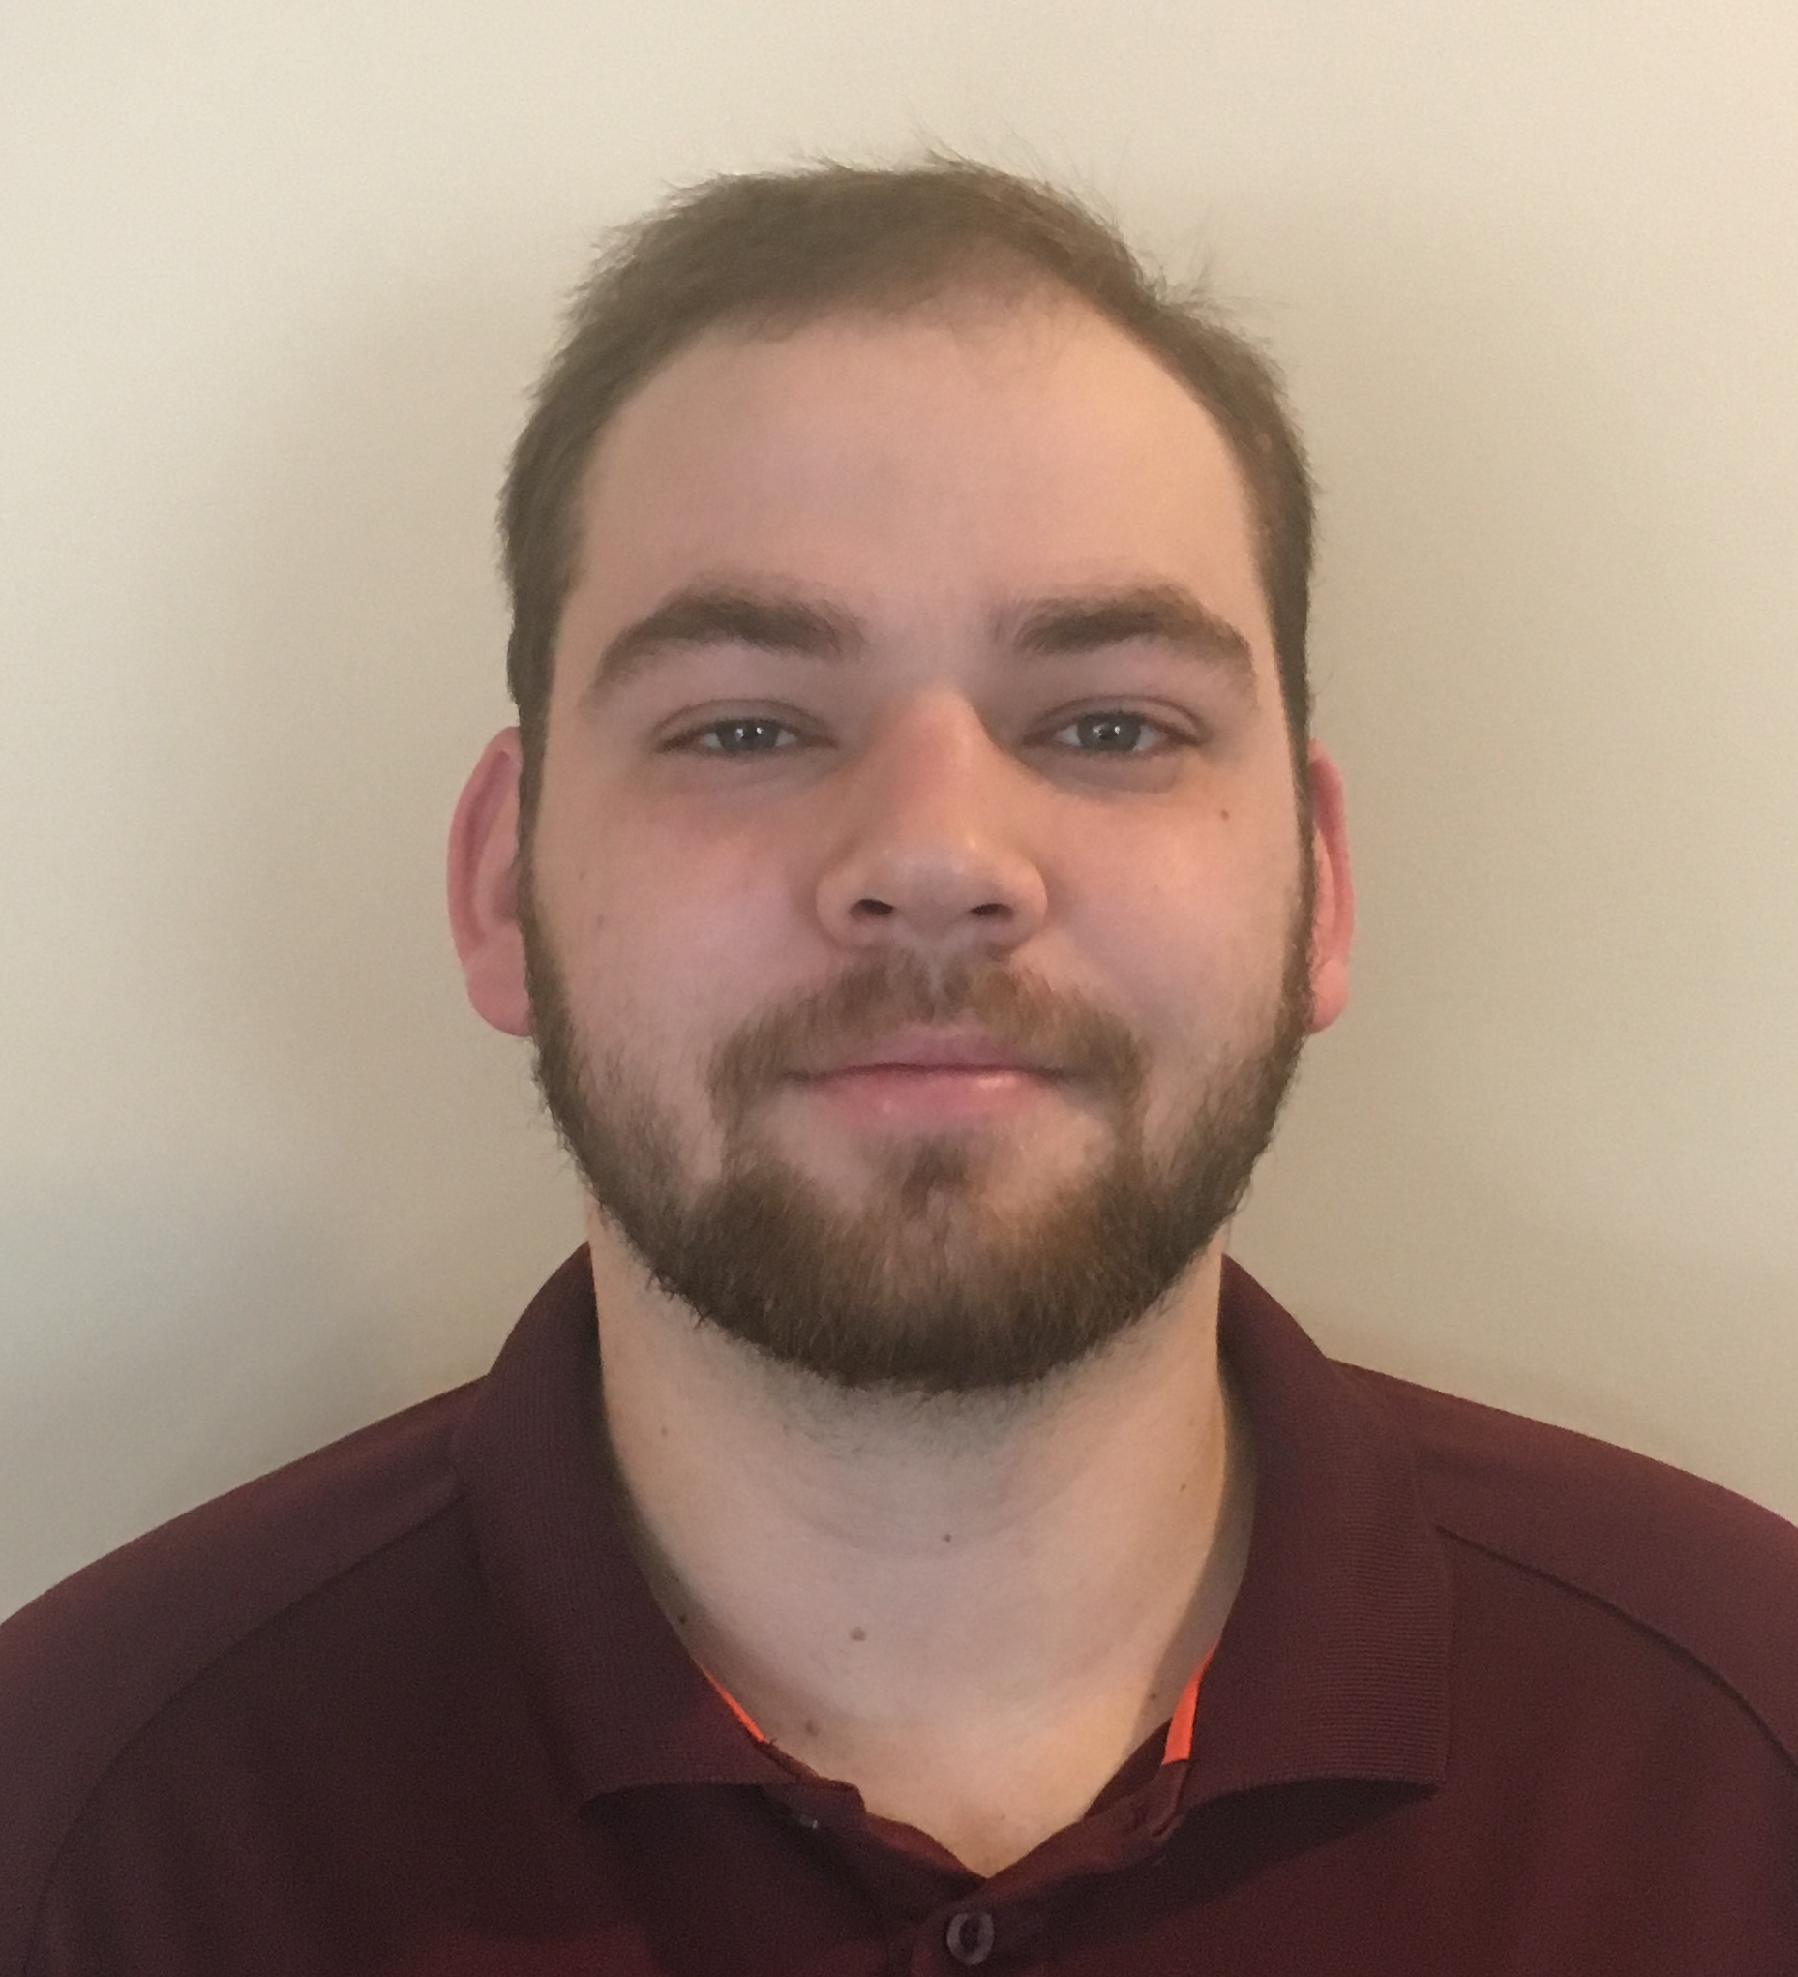
The Course Staff
Other instructor
GTA: Xiaolong Wu
UTA: Henry Wang
Notes:
This slide is meant to show photos of the other course staff. In particular, you can show photos of the other instructors and teaching assistants, and give their names. You want students to be comfortable approaching the teaching assistants. This information should also be on the course site.

Slide 4

Who are You?
What is your major?
In what year are you?
What is your gender?
Why are you here?
Notes:
These statistics break down who the students are and give them a sense of who their classmates are. These numbers are accurate for Fall 2017.

Slide 5
Force-Add
All requests must be submitted by the Friday before classes start (too late now)
Check department website for more info: https://www.cs.vt.edu/undergraduate/survey
If you have any questions/inquiries contact csundergrad@cs.vt.edu and explain your situation.
Do not stop by the CS office to make an appeal in person!
Notes:
You may have a different force-add policy, but this is the current one for the department.

Slide 6

Intro to Programming in Python
Notes:
Remind the students that this course is named "Introduction to Programming in Python", and therefore they will be learning to program in Python.
This course has no prerequisites
Although some students have prior experience, it is assumed that you have no prior programming experience
Basic digital literacy is expected – you should know how to use a web-browser

Slide 7
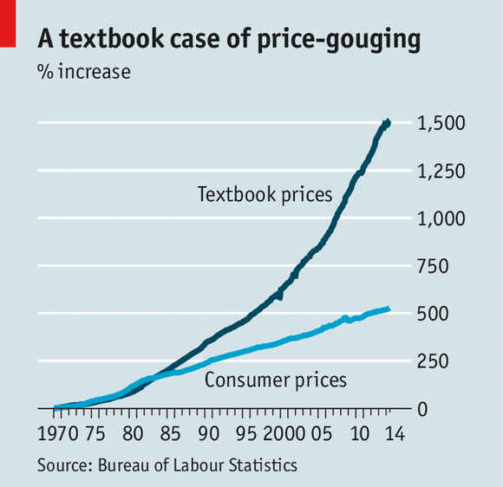
Textbook
NO TEXTBOOK!
…but you can use instead:
How to Think like a Computer Scientist
online and free.
Automate the Boring Stuff with Python
online and free.
Coding for Beginners in Easy Steps
available on Amazon for fairly cheap.
Notes:
There is no required textbook for the course.
There are three optional textbooks available, two of which are free online.
Some lessons will have readings highlighted for it.
But again, no one is required to buy any textbooks.

Slide 8

Course Format
Each week is a new module composed of 2-8 lessons
Each lesson is composed of:
Video/Slides/Transcript of material
Canvas quiz
Programming problems
Some modules have a mini-project, survey, or ethics activity
Notes:
This is when you outline the major course format.
You want to explain the weekly module format, and the format of lessons.
Mention that lessons do not necessarily always have a quiz and programming problems, but they will have one of those.
You can speak a little bit about the video lessons – students should check them out, but they can also just read the transcript or skim the slides if they feel confident about the material.
Don't worry about explaining anything too in-depth at this point.

Slide 9

Open/Lock Dates
Module opens all at once the Friday before class
Module locks two weeks later
No late submissions/penalties
Notes:
All the assignments for a module open the Friday before the module starts
Those assignments will lock two weeks later
Recommend that they complete assignments during their week, rather than waiting till the deadline
Once a module locks, no submissions are possible (don't waver on this – you'll be eaten alive reopening assignments)
But on the plus side, there are no late penalties.

Slide 10
Class Time
Lecture
1
Group work
2
Lab time
3
Code examples
Introduce topic
Use iClickers
Reinforce concepts
Programming problems
Get help from staff
Notes:
Depending on how you plan to use classtime, you might modify this.
I tell them that I lecture for about ~20 minutes (some slides, performances, code examples) to reinforce the important bits of lessons.
Then I usually have the rest of classtime open for students to work on problems and ask the staff questions.
If we see you leave, and then you show up in our office hours later, don't expect much sympathy or attention.
Class time is the ideal time to get help.
We'll talk about the groupwork aspect when it becomes relevant.

Slide 11

Attendance
We do not take attendance in this course.
However, there are graded, in-class activities that you will need to complete most days.
These assignments must be completed in class.
You need an i>Clicker to participate and get credit.

Slide 12
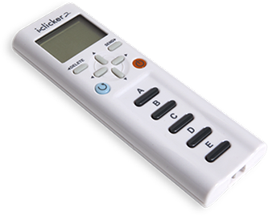
Technology in the class
Laptop
Necessary for all the programming assignments
Make sure you install Anaconda (Programming #2)
Can be used for other in-class activities
i>Clicker
Used for the in-class quizzes (starting next week)
Make sure you register your device on Canvas
Can probably buy a used one for cheap.
Notes:
Clickers are required.
They must be the regular i>clicker – these shouldn't be too expensive, can probably get a used one for cheap.
Laptops are also required.
You'll be doing a lot of work in class.

Slide 13
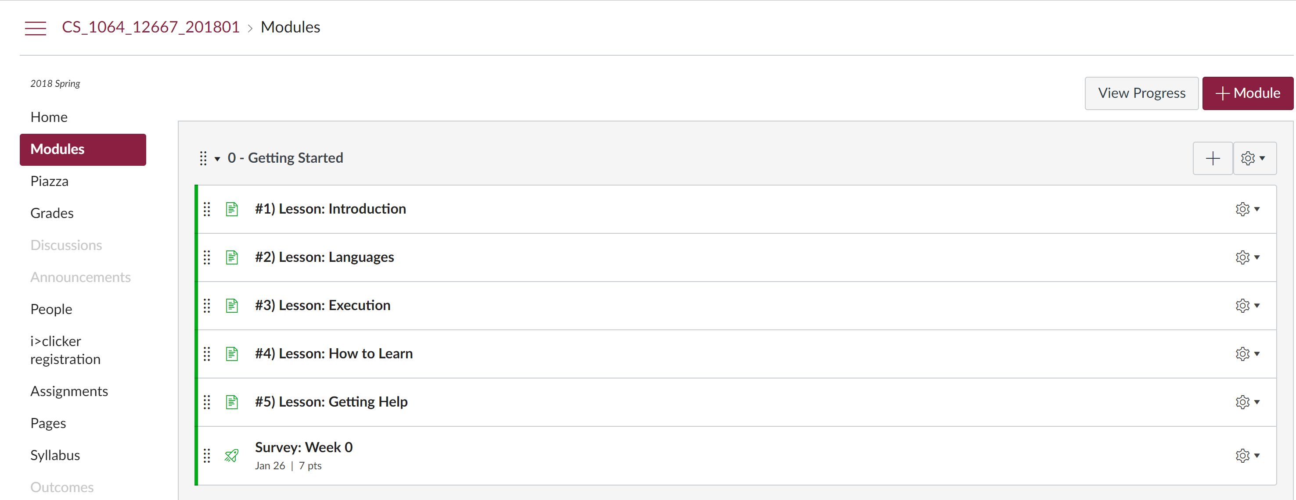
Canvas Site
Notes:
This is a chance for a demo of the canvas site. You should walk through the following in the Student View:
The navigation tabs on the left
The Module view
What an individual lesson looks like ("#1) Lesson: Introduction")
How to look at the video
How to show the transcript under the video (there's a button for Show/Hide transcript)
How to access the slides
How to access the lesson's assignments
What a quiz looks like
Today's programming assignment (Maze game)
What the Grades menu looks like, how to go to a submission and then the assignment for that submission
Show the syllabus page
Show the Course Staff page
Go to the Piazza, demonstrate how to make a post

Slide 14






Getting Help
Piazza
Office hours
Textbook
Classmates
Google
Schedule for TAs
E-mail instructor
Suggested list on Canvas
Make friends
…is also your friend!
Notes:
Let them know the major sources of help.
The piazza is one of the most preferred ways. They need to follow its rules: no posting code publicly (honor code violation).
There are also office hours scheduled, and of course the class time.
They can get help from each other, but need to be careful.

Slide 15
Finals
Exam
Project
Cumulative
Assess understanding
Master material
Mini-projects throughout
Review last two weeks
Big final project
Notes:
Break the bad news that there is a final exam and a final project.
The exam is cumulative, will talk more about it nearer the end of the semester.
Exams are important for assessing their understanding and motivating them to master the material.
There are several mini-projects throughout the course, and then one big final project.
A lot of class-time will be dedicated to working on the final project.

Slide 16
Cheating, Collaboration, Communication
No code from anyone besides the course staff.
Doing so is an honor code violation, and we have ways of detecting that (e.g., MOSS).
When you get help from peers, it can only be high level conceptual help or motivational.
You are encouraged to help each other, but do not share code or look at each other's solutions.
All of this is laid out in the Cheating Collaboration Communication Page on Canvas.
Notes:
They must not take code from anyone besides the course staff.
Doing so is an honor code violation, and we have ways of detecting that (e.g., MOSS).
When you get help from peers, it can only be high level conceptual help or motivational.
You are encouraged to help each other, but do not share code or look at each other's solutions.
All of this is laid out in the Cheating Collaboration Communication Page on Canvas.

Slide 17

Any Questions?
Notes:
I usually let them ask whatever questions they have now.

Slide 18


Lab Time
Work on class assignments
Finish as many problems as possible
Use instructor and TA’s time for assistance
DO NOT LEAVE
Unless you're on fire or something
We will note if you leave and come during office hours
Notes:
Many will leave, but ask them to stay and work on assignments. You can check to see how many are actually done before class starts, and gauge if too many are leaving. Still, the early material is easy so don’t necessarily need to hold them down.

